Slide 1
DIABETES IN THE MID-SHORE
APRIL 22, 2021

Slide 2
WHAT IS DIABETES?
Chronic disease that affects the way the body handles glucose (sugar in blood used by body for energy)
  Type 1 Diabetes: When body does not produce enough insulin which is necessary to allow glucose into cells to provide energy; often diagnosed in childhood
  Type 2 Diabetes: When body does not properly use insulin (more common form of diabetes); related to overweight and obesity
  Gestational Diabetes: Occurs in pregnancy
  Prediabetes: When blood sugar levels are elevated but not enough to be considered diabetes
Notes:
Gestational Diabetes: Gestational diabetes is diabetes that starts during pregnancy and occurs when a pregnant woman is not able to make and use all the insulin needed during pregnancy, which results in high blood sugar. Factors such as multiple pregnancies and being overweight or obese at the beginning of the pregnancy greatly increase the risk of gestational diabetes. Pregnant women with gestational diabetes tend to have larger babies, and mothers have an increased risk of high blood pressure and infections during pregnancy. Women with a history of gestational diabetes are at risk of developing gestational diabetes for future pregnancies. Although gestational diabetes usually resolves after pregnancy, women who have gestational diabetes in their pregnancies are at an increased risk for developing type 2 diabetes later in life. In Maryland, the rate of gestational diabetes increased from 5.4 percent in 2013 to 7.3 percent in 2017, and has far-reaching consequences for the health of women, as well as the health of their babies by increased risk for diabetes.
Prediabetes: Prediabetes is a condition where blood sugar levels are higher than normal, but not high enough to be considered diabetes. Prediabetes is a precursor condition on the pathway from normal glucose levels to type 2 diabetes; the development of type 1 diabetes is usually so rapid that there is no “prediabetes” state that precedes type 1 diabetes. Prediabetes often goes unrecognized by both individuals and their health care providers and 9/10 adults who have prediabetes do not know they have it. CDC estimates that 34 percent of U.S. adults have prediabetes. While prediabetes does not “cause” diabetes per se, it represents points in the chain of progression to diabetes that are very near to crossing the threshold to a diagnosis of diabetes.

Slide 3

DIABETES ACTION PLAN
Released in June 2020 from MDH
Recommends multi-faceted strategy to address diabetes
Collaborative effort between healthcare partners and community organizations to align resources, efforts, and funding

Slide 4
DIABETES IN MARYLAND
1 in 10 adult Marylanders has diabetes
  1 in 3 adult Marylanders has prediabetes
Disproportionately impacts racial/ethnic minorities and those with less education, lower income, and various disabilities

Slide 5
623,000
Marylanders living with diabetes

Slide 6
1,600,000
Marylanders living with pre-diabetes
(but only 10.5% are aware of their status)

Slide 7
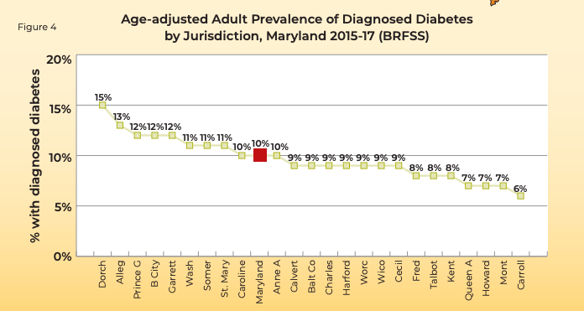

Slide 8
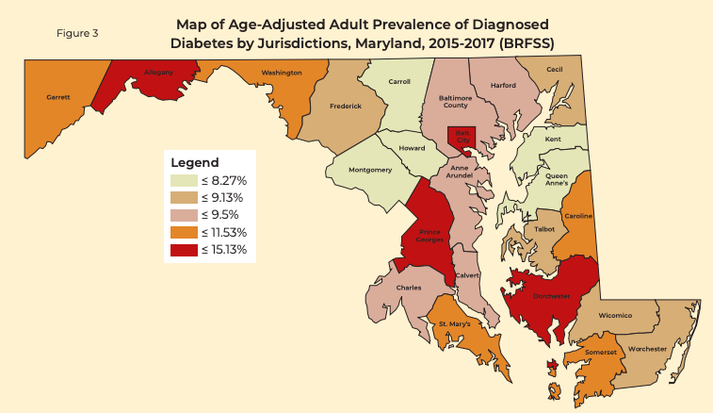

Slide 9
HEALTH CONSEQUENCES OF DIABETES IN MARYLAND
6th leading cause of death in the State
  May be even higher as diabetes is risk factor for other common causes of death (ex. heart disease and stroke)
Complications include heart disease and stroke, blindness, amputations, nerve damage, and kidney disease

Slide 10
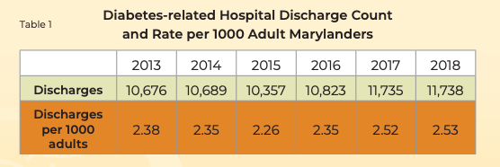
DIABETES HOSPITAL UTILIZATION RATES
In 2017, there were 121,301 Emergency Department (ED) visits related to diabetes
Notes:
Diabetes ED Visits: In 2017, there were a total number of 121,301 ED visits related to Diabetes. This indicates a rate of 20.23 visits per 1,000 Marylanders.
Diabetes Related Hospital Discharge Count: In 2018, a total of 11,738 hospital discharges were reported with diabetes as the primary diagnosis among Maryland adults, which is equivalent to 2.5 hospital discharges per 1,000 Maryland adults.

Slide 11
FINANCIAL BURDEN OF DIABETES
In 2017, costs for diabetes-related hospital stays increased from $150 million in 2013 to $197 million
Medicaid enrollees with diabetes vs. without diabetes are:
  2.4x more likely to have an inpatient admission
  1.3x more likely to have an ED visits
  1.1x more likely to have an ambulatory visit
Notes:
Diabetes Inpatient Hospital Charges: In 2017, Maryland hospitals charged approximately $197 million for diabetes-related hospital stays for Marylanders, compared to $150 million dollars in 2013, an increase of more than 30 percent. This estimate includes Maryland residents of all ages with a primary diagnosis of diabetes or a diabetes-related complication (such as lower-extremity amputation). The estimate excludes patients seen in the Emergency Department (ED) and released without an inpatient stay.

Slide 12
FINANCIAL BURDEN OF DIABETES
Costs for diabetes are estimated at $7.01 billion every year
  Direct medical expenses = $4.92 billion
  Indirect costs from lost productivity: $2.09 billion
People with diabetes cost the State’s Medicaid program 2x as much as those without diabetes
Notes:
Cost Burden of Diabetes: Diabetes and prediabetes cost an estimated $7.01 billion in Maryland each year. People with diabetes have medical expenses approximately 2.3 times higher than those who do not have diabetes. Total direct medical expenses for diagnosed and undiagnosed diabetes, prediabetes and gestational diabetes in Maryland was estimated at $4.92 billion in 2017. In addition, another $2.09 billion was spent on indirect costs from lost productivity due to diabetes.
Medicaid Costs of Diabetes in Maryland: People with diabetes cost the State's Medicaid program twice as much as those without the chronic condition.

Slide 13
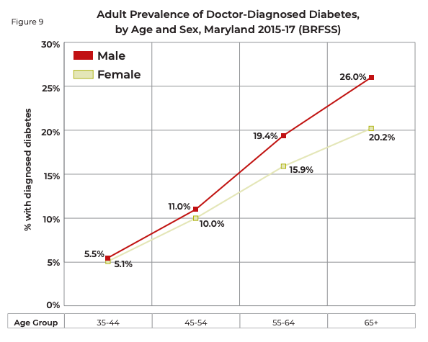
DIABETES BY AGE AND SEX
Risk increases with age
Diabetes is more common in men ages 55+, but national incidence rates between men and women are similar
Notes:
Diabetes is more common in older adults. In Maryland, in 2015-17 combined, about 26 percent of men and 20.2 percent of women aged 65 and older had been diagnosed with diabetes compared to about 5 percent of adults aged 35-44. Diabetes in older adults has been linked to a reduction in functional status, higher mortality, and increased risk of institutionalization. The increasing prevalence of diabetes with advancing age is part of the natural history of the disease, which means that these age differences are not an “age disparity.” Obesity is more common at older ages, which increases insulin resistance, and reduction of insulin secretion also occurs at older ages. While age is not a modifiable factor, understanding age effects is important to evaluating other determinants and risk factors.
Gender is generally not considered to be a risk factor for diabetes. In Figure 9, male and female prevalence is essentially the same below age 55. While there are somewhat higher rates for males at ages 55 and older, this does not mean that females should be considered a “low risk” group as national incidence rates between males and females are similar.

Slide 14
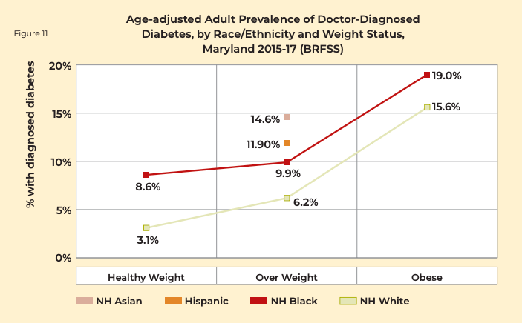
DIABETES AND WEIGHT
Risk increases weight weight
Higher BMI = greater abdominal fat = increased insulin resistance = production of higher levels of blood glucose
Notes:
In Maryland, as in the nation, the prevalence of diabetes increases as weight classification moves from healthy weight, through overweight, and to obesity. As seen in Figure 11, in Maryland there is a small step-up in diabetes prevalence between healthy weight and overweight, and a larger step-up in prevalence between overweight and obesity. This relationship of prevalence to weight status is similar for Non-Hispanic Blacks and Non-Hispanic Whites. In addition, Figure 11 shows that the higher diabetes prevalence for minorities presented earlier (Figure 2) persists within weight categories, with Non-Hispanic Black diabetes prevalence higher than Non-Hispanic White in all weight categories, and Hispanic and Asian prevalence higher at overweight. This indicates that the racial/ethnic disparity in diabetes prevalence is not simply an issue of more excess weight in minority populations, although for some groups that contributes to the disparity. Higher BMI correlates with greater abdominal fat, and abdominal fat increases insulin resistance, which can produce high levels of blood glucose. Insulin is produced by the pancreas and is the hormone that moves the sugar out of the blood and into the cells. When an individual has excess body fat, the body’s cells become resistant to insulin, which is why overweight and obesity are risk factors for diabetes. The body’s response to insulin-resistant cells increases insulin production to the point that the pancreas begins to fail to keep up with the insulin demand. Failure to produce and/or utilize enough insulin results in diabetes.

Slide 15
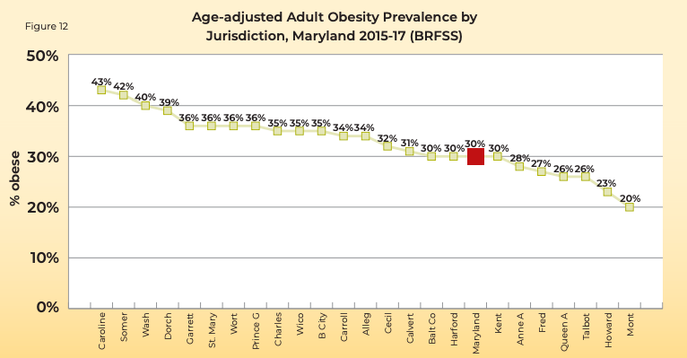
Notes:
Based on data from 2017, in Maryland, 34.6 percent of the population is overweight, and 30.8 percent of the population is obese. There is a wide range of obesity prevalence rates by jurisdiction in Maryland, ranging from a low of 20 percent in Montgomery County to a high of 43 percent in Caroline County. Several factors influence the obesity prevalence rate in a jurisdiction, including the racial and ethnic mix and the socio-economic status of the population

Slide 16
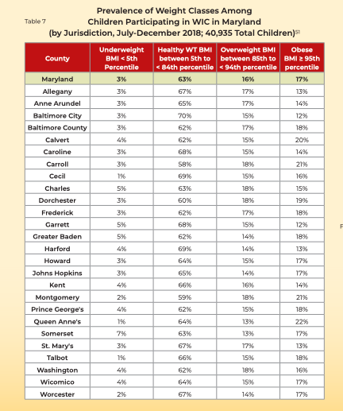
DIABETES AND WEIGHT IN CHILDREN
Maryland does not have state-level data on diabetes in children
26.4% of high schoolers in MD are overweight/obese
Notes:
Maryland does not have state-level data on diabetes in children but state level data on overweight and obesity is available. According to the 2016 Youth Risk Behavior Survey, 26.4 percent of Maryland high school students are overweight or obese. Based on this data, interventions and strategies to address overweight and obesity must be targeted to children and youth as well as adults to prevent diabetes.

Slide 17
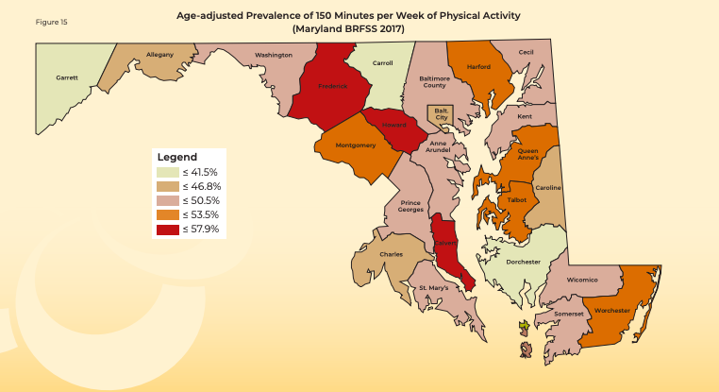
DIABETES AND PHYSICAL ACTIVITY
Risk of diabetes increases with decreased level of physical activity
Notes:
Adults should get at least 150 minutes of physical activity each week and children should be active for at least 60 minutes a day. A sedentary lifestyle puts individuals at increased risk for developing a variety of chronic health conditions, including type 2 diabetes. The adult prevalence of diagnosed diabetes is higher in those who do not meet weekly physical activity guidelines compared to those who do meet those guidelines.The jurisdiction-specific prevalence of meeting the 150 minute per week physical activity recommendation is mapped in Figure 15.

Slide 18
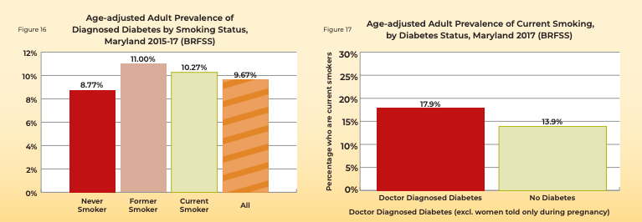
DIABETES AND TOBACCO
Smokers are 30-40% more likely to develop diabetes
People with diabetes who smoke are at an increased risk for diabetes-related complications like heart disease and stroke
Notes:
Smokers have a 30 percent to 40 percent higher risk of developing diabetes compared to non-smokers. Studies have shown that smoking can increase blood sugar levels and decrease the body’s ability to use insulin. People with diabetes who smoke need larger doses of insulin to control their blood sugar than those who do not smoke. Smoking can increase the risk of certain diabetes complications, including heart disease, heart attacks, stroke, peripheral vascular disease, and amputations. In Maryland, the adult prevalence of diagnosed diabetes is higher in current and former smokers than it is in non-smokers: about 8.8 percent of non-smokers have diagnosed diabetes, compared to 11.0 percent and 10.3 percent of former and current smokers, respectively. Because smoking is a synergistic cause with diabetes for large blood vessel complications, smoking is an important risk factor to target among persons with diabetes. As seen in Figure 17, in 2017, 17.9 percent of Maryland adults with diabetes were current smokers, compared to the 13.9 percent proportion of current smokers among adults without diabetes.

Slide 19
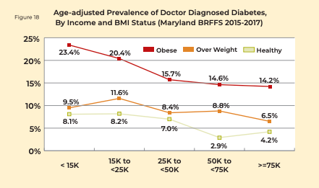
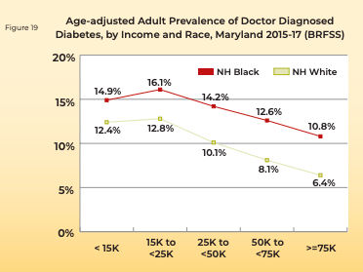
DIABETES AND INCOME
Notes:
The prevalence of diabetes is strongly determined by income. As seen in Figure 18 and Figure 19, prevalence of diagnosed diabetes is higher for adults with income below $15,000 compared to adults with income at or above $75,000. This gradient of higher diabetes prevalence at lower levels of income is seen in all three weight classifications, including healthy weight, overweight and obese. In addition, Figure 18 shows that for every level of income, diabetes prevalence is higher for the obese weight group. Income and weight status are independent determinants (causes) of diabetes.

Slide 20
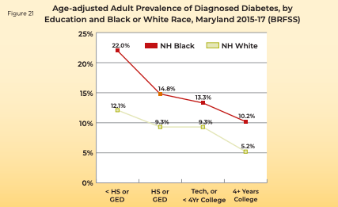
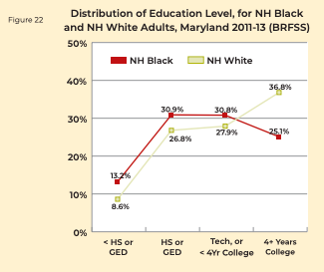
DIABETES AND EDUCATION LEVEL
Notes:
The prevalence of diabetes is strongly determined by level of education. As seen in Figure 21, adult prevalence of diagnosed diabetes is more than twice as high for persons with less than high school education compared to persons with a college degree or more education. Income and education are closely related to each other, with higher educational attainment being associated with higher income at the population level.

Slide 21
DIABETES AND HEALTH LITERACY
Health literacy: Degree to which individuals have the capacity to obtain, process, and understand basic health information and services needed to make appropriate health decisions
  More significant among lower socioeconomic and minority groups
Limited health literacy impairs individual’s ability to effectively manage their diabetes
Notes:
The Office of Disease Prevention and Health Promotion (ODPHP) defines health literacy as “the degree to which individuals have the capacity to obtain, process, and understand basic health information and services needed to make appropriate health decisions. Limited health literacy affects people of all ages, races, incomes, and education levels, but the impact of limited health literacy disproportionately affects lower socioeconomic and minority groups. It affects people’s ability to search for and use health information, adopt healthy behaviors, and act on important public health alerts. Limited health literacy is also associated with worse health outcomes and higher costs." Limited health literacy reduces the use of preventive services and impairs the management of chronic conditions such as diabetes. Limited health literacy is also associated with higher rates of preventable hospital visits and admissions.

Slide 22
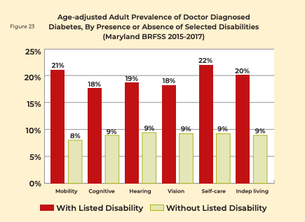
DIABETES AND DISABILITY
Adult prevalence of diabetes is 2x as high among people with disabilities
In some cases, disability may be a result of the diabetes or vice versa
People with a disability and diabetes often have higher rates of unemployment, job absenteeism, and health care utilization
Notes:
A disability is any condition or impairment of the body or mind that makes it more difficult for the person with the condition to do certain activities and interact with the world around them. More than 21 million US adults have a disability. Disability and diabetes are interrelated. The adult prevalence of diagnosed diabetes in Maryland is consistently about twice as high among persons with mobility, cognitive, hearing, vision, self-care, or independent living disabilities compared to persons without those disabilities. In some cases, disability may cause the diabetes, as in the situations where the disability limits physical activity and thus increases the risk of overweight or obesity. In other cases, the disability may be the result of the diabetes, for example when diabetes causes vision loss and produces vision disability. People with disability who have a diagnosis of diabetes often have higher rates of unemployment, absenteeism on the job, and health care utilization, and lower income levels and capabilities in personal care and activities of daily living.

Slide 23
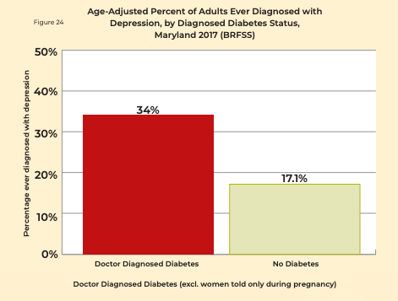
DIABETES AND MENTAL HEALTH
People with diabetes are at increased risk for diabetes distress
  Ex. depression, anxiety, eating disorders, substance use disorders
Mental illness reduces the likelihood a person with diabetes will be properly treated
Notes:
Research shows that people with diabetes are at increased risk for diabetes distress, which refers to the negative emotional and psychosocial worries and burden individuals with the diagnosis of diabetes experience. Diabetes distress could manifest as depression, anxiety disorders, eating disorders, inappropriate stress responses, substance use disorders, and alcohol abuse. The relationship of a diagnosis of depression with a diagnosis of diabetes among adults in Maryland is shown in Figure 24: the percent ever diagnosed with depression is about twice as high for adults with a diagnosis of diabetes (34 percent) as for adults without a diagnosis of diabetes (17 percent). People who have mental health conditions are at an increased risk for developing diabetes and untreated mental health conditions can make the management of diabetes more difficult. People with untreated mental health conditions often deal with issues like poor self-care, improper nutrition, barriers to accessing primary care and mental health care, and lack of exercise. Mental illness reduces the likelihood a person with diabetes will be properly treated.

Slide 24
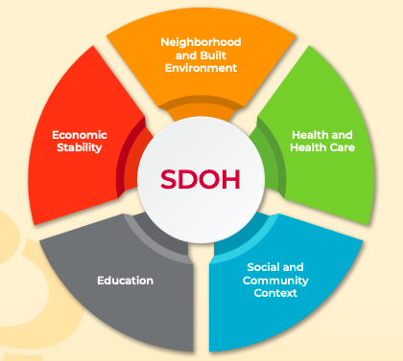
Notes:
Social Determinants of Health are the conditions in which people are born, grow, live, work and age. SDOH have an impact on many chronic diseases like diabetes. The Maryland data provided earlier show an increased prevalence of diabetes among people with lower levels of income and education, and among racial and ethnic minorities. People in these categories often may not have the financial means to pay for healthier foods, may struggle with food security, and may not have safe areas for physical activity. The stress related to poverty and racism has physiologic effects that can promote the progression to diabetes as well as impacting diet and physical activity behaviors. All these societal issues affect a person’s health. This photo depicts the five main categories of social determinants of health which is the framework used by Healthy People 2020.

Slide 25
DIABETES AND HEALTH EQUITY
Health equity: The attainment of the highest level of health for all people.
Health disparity: A particular type of health difference that is closely linked with social, economic, and/or environmental disadvantage.
Maryland data shows differences in diabetes prevalence based on age, race/ethnicity, geography, level of income, and level of education
  Diabetes outcomes are not just a result of individual lifestyle factors
Notes:
Healthy People 2020 defines health equity as the “attainment of the highest level of health for all people. Achieving health equity requires valuing everyone equally with focused and ongoing societal efforts to address avoidable inequalities, historical and contemporary injustices, and the elimination of health and health care disparities.” Healthy People 2020 defines a health disparity as “a particular type of health difference that is closely linked with social, economic, and/or environmental disadvantage. Health disparities adversely affect groups of people who have systematically experienced greater obstacles to health based on their racial or ethnic group; religion; socioeconomic status; gender; age; mental health; cognitive, sensory, or physical disability; sexual orientation or gender identity; geographic location; or other characteristics historically linked to discrimination or exclusion.” The Maryland data presented above have shown differences in diabetes prevalence in high burden populations, such as by age, by race/ethnicity, by geography, by level of income and by level of education. Determinants such as poor diet, low physical activity, overweight/obesity, and high chronic stress drive physiologic changes that lead to diabetes. Social determinants such as income, education, housing, unsafe neighborhoods, food insecurity, lack of transportation, and lack of health care access drive differences in diet, activity, stress and preventive care regardless of race. Finally, racial injustice has produced persistent disadvantage in social determinants of health for racial and ethnic minority populations, creating racial/ethnic disparities in diabetes outcomes.
In order to improve diabetes rates and outcomes, multiple factors must be addressed. For example, interventions should address both the physiologic determinants of diabetes (ex. unhealthy diet, low physical activity, and stress) as well as the social determinants of diabetes(ex. income, education, housing, lack of healthcare access).

Slide 26
THANKS!
ANY QUESTIONS?
Email mdlhic@umd.edu

Slide 27
REFERENCES
Diabetes Action Plan
https://www.diabetes.org/
https://www.countyhealthrankings.org/app/maryland/2020/compare/snapshot?counties=24_011%2B24_019%2B24_029%2B24_035%2B24_041
https://phpa.health.maryland.gov/ccdpc/diabetes/pages/prevention.aspx#:~:text=Prediabetes%20in%20Maryland,weight%20loss%20and%20physical%20activity.

