Slide 1


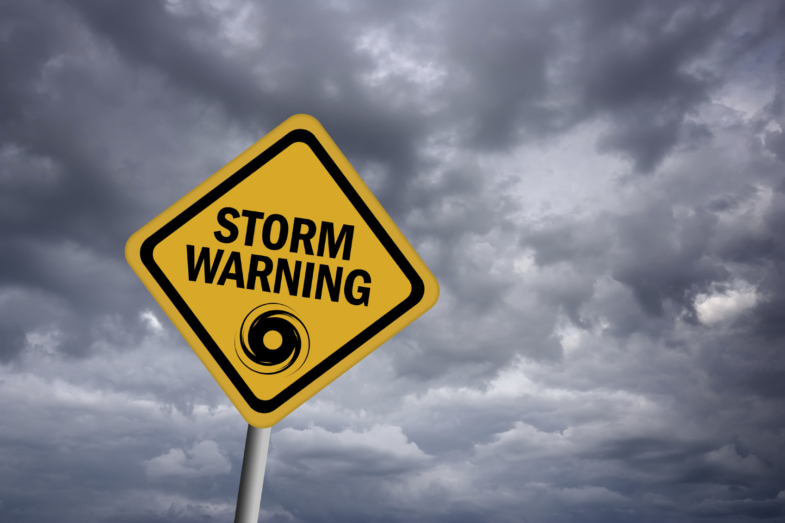
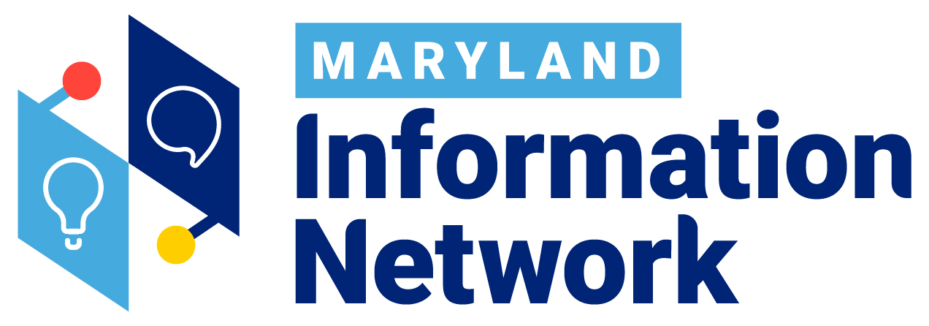
The Maryland Information Network
is the central connector to essential health and human services and disaster response for the state of Maryland.
We provide system efficiency & benefits with our 24-hour info/referral & crisis line available 365 days a year by phone, text, chat or website search.
Accredited Call Centers staffed w/ Certified Community Resource & Crisis Specialist
American Association of Suicidology
National Suicide Prevention Lifeline
International Council for Helplines
CARF –Outpatient Mental Health Clinic Status
Mental Health First Aid

Slide 2

TEXT THESE HASTAGS TO 898-211
#MDAging
#MDMindHealth
#MDSaludMental
#MDYoungMinds
#MDKinCares
#MDCom2Vets
#MDHope
#MDStopHate
TEXT THIS HASTAG TO 211-MD1
#MDReady
211 MARYLAND PODCAST
30-minute podcast to discuss local & statewide resource information.

Slide 3
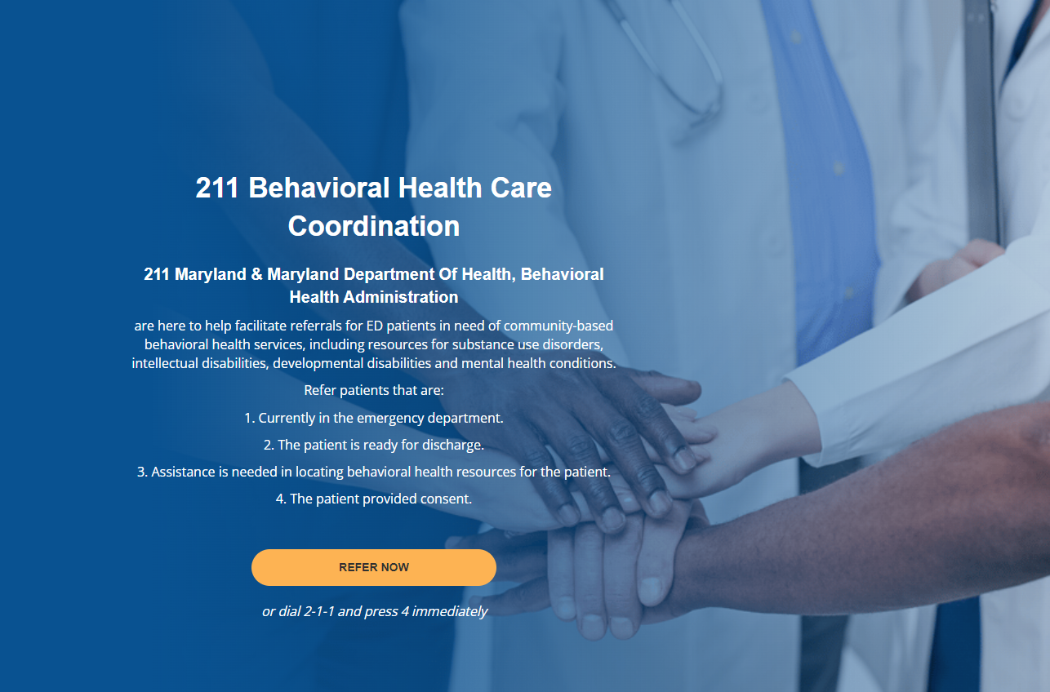
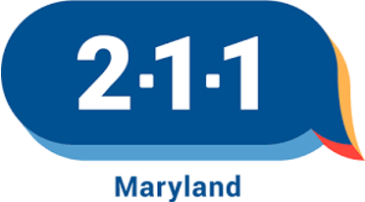
211 Behavioral Health Care Coordination

Slide 4
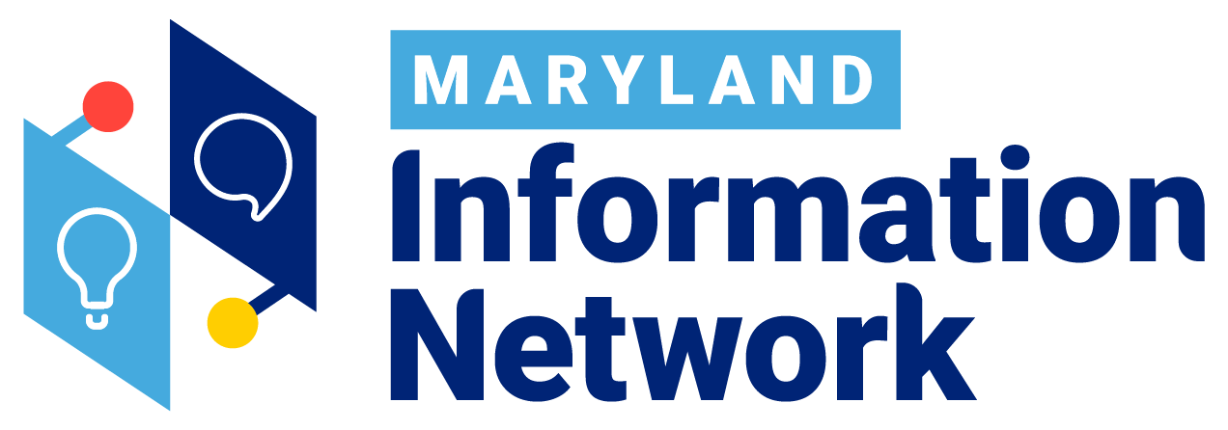
Partnership Service List
The Vision
A high-quality, single source of truth for Maryland community resource information.
Benefits
Higher degree of confidence in public program listings.
Assigned support for questions or resource update needs
A filterable list of registered programs for better measurement of resource gaps.

