Slide 1
Legislative Impacts in Rural Maryland:
Workforce Development and Telehealth Access
Sara Seitz
Director, Maryland State Office of Rural Health
November 15, 2022
Mid-Shore Local Health Improvement Coalition

Slide 2
State Office of Rural Health
1.) Serve as a focal point and state clearinghouse for collection and dissemination of information regarding rural health issues
2.) Provide coordination of rural health programming across the state and in identified priority areas to avoid redundancy of efforts among public health and health care entities; and
3.) Deliver technical assistance to rural-serving public and non-profit private entities to build capacity to access state and federal resources.

Slide 3
Office of Health Care Workforce Development
Recruitment and retention efforts to increase health care workforce to underserved Maryland areas:
Conrad 30 (J-1 Visa Waiver) Program
Maryland Loan Repayment Programs (MLRP)
Income Tax Credit for Preceptors in Areas with Health Care Workforce Shortages

Slide 4
Health Care Workforce

Slide 5
Health Care Workforce
2022 Legislative Session
Bill Number | Bill Name | Summary
SB626 | Maryland Loan Repayment Program (MLARP) for Physicians and Physician Assistant-Alteration | +Part-time physicians/PAs +Permanent Advisory Group
SB696/ HB0975 | Maryland Loan Assistance Repayment for Nurses and Nursing Workers–Program Establishment and Funding | +Nurses and nursing support staff to MLARP +Stakeholder workgroup
HB1208 | Health Occupations-Health Care Workforce Expansion | + RN and LPN Preceptorship Tax Credit Fund + Workgroup to study expanding the State apprenticeship programs to the health care workforce
SB440/HB625 | Commission to Study the Health Care Workforce Crisis in Maryland–Establishment | + Commission to Study the Health Care Workforce Crisis in Maryland

Slide 6
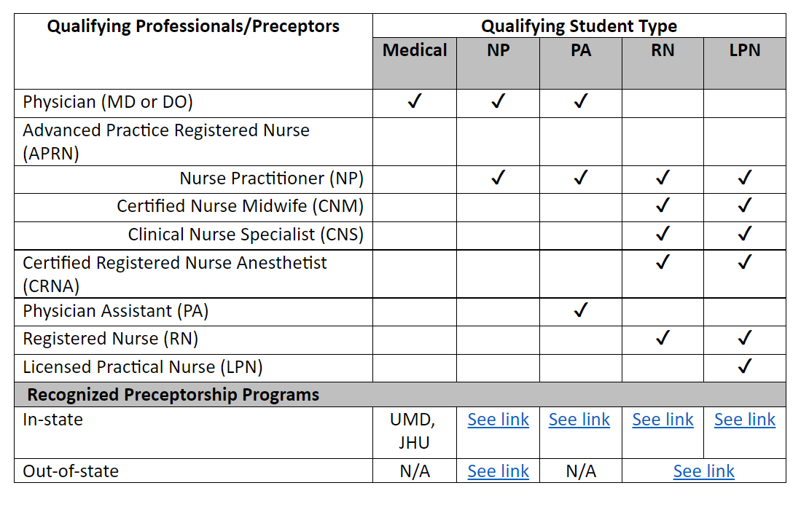
Legislation, Law (Code), and Regulations (COMAR)
The Preceptor Tax Credit Programs are authorized via State law as follows:
Physicians (Medical School) Student Preceptors: Tax–General Article, §10–738, Annotated Code of Maryland
Originating Bill: Senate Bill 0411 (2016)
Nurse Practitioner Student Preceptors: Tax–General Article, §10–739, Annotated Code of Maryland
Originating Bill: Senate Bill 0411 (2016)
Physician Assistant Student Preceptors: Tax–General Article, §10–752, Annotated Code of Maryland
Originating Bill: Senate Bill 0102 (2021)
Registered Nurse & Licensed Practical Nurse Student Preceptors: Tax-General Article, §10-739-1, Annotated Code of Maryland
Originating Bill: House Bill 1208 (2022)

Slide 7
Health Care Workforce Resources
MD Loan Repayment Programs: https://health.maryland.gov/pophealth/Pages/State-Loan-Repayment-Program.aspx
  Includes links to MLARP Workgroup and Advisory Councils
  Includes link (near bottom) to receive Office updates (J-1, MLRP, and Tax Credit for Preceptors)
Tax Credit for Preceptors: https://health.maryland.gov/pophealth/Pages/taxcredit.aspx
Commission to Study the Health Care Workforce Crisis: https://health.maryland.gov/Pages/Workforce-Commission.aspx
Maryland General Assembly: https://mgaleg.maryland.gov/mgawebsite

Slide 8
Telehealth Access

Slide 9
Preserve Telehealth Access Act of 2021
HB123 (2021)
Expanded Maryland Medicaid telehealth coverage
Set sunsets on 2 areas of expansion (June 30, 2023)
  Audio-only allowances
  Payment parity with in-person visits
Mandated research facilitated by the Maryland Health Care Commission (Report and recommendations due December 1, 2022):
  https://mhcc.maryland.gov/mhcc/Pages/hit/hit_telemedicine/hit_telemedicine_legislative_update.aspx

Slide 10

National Rural Health Day
https://health.maryland.gov/pophealth/Pages/national-rural-health-day.aspx

Slide 11
Sara Seitz, MPH
Director, State Office of Rural Health
Maryland Department of Health
sara.seitz@maryland.gov
Questions?

